Slide 1
Telecom Billing and Services Analysis
Introduction –
This Power BI report provides a comprehensive analysis of customer churn patterns in the telecom sector. Leveraging interactive dashboards and dynamic visuals, the report identifies key drivers of churn across demographics, regions, service types, and payment behaviors.
The goal is to support data-driven decision-making by uncovering at-risk customer segments, highlighting late payment trends, and evaluating service engagement to inform targeted retention strategies.
Objectives-
The main objectives are to obtain insights into the particular customers who have taken plans for three kinds of service: TV, Phone, and Internet.
The company has created bills for customers that include all three services based on their contract types by month end.
Customers who had taken service on contract types consist of their plan, which are active and inactive .
The objective is to get insights into why certain customers who are not continuing their plan by non non-active status.

Slide 2
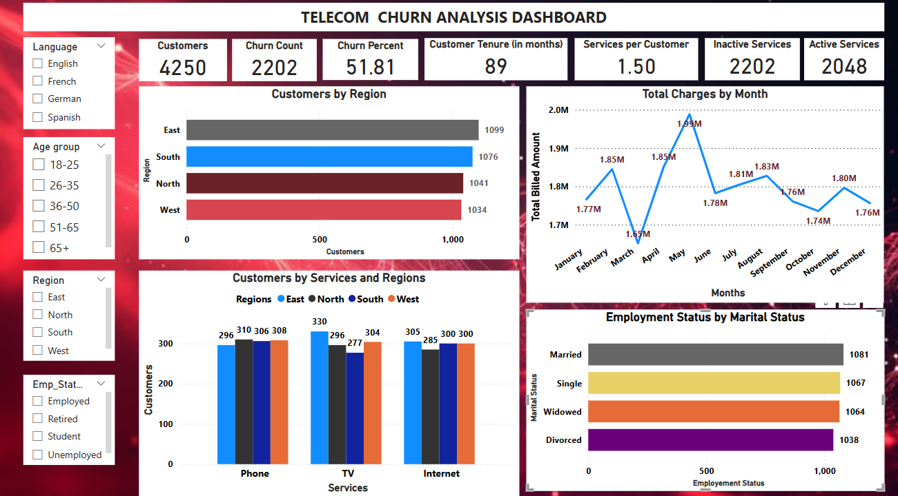

Slide 3
Overview :
Metric | Value
Total Customers | 4,250
Churn Count | 2,202
Churn Percentage | 51.81%
Average Tenure | 89 months
Services per Customer | 1.50
Inactive Services | 2,202
Active Services | 2,048
Insights: A churn rate above 50% is alarming. Addressing customer dissatisfaction and retention strategies should be a priority.
Churn Rate: At 51.81%, this is very high. Over half the customer base has churned.
Inactive vs Active Services: Almost equal split, with inactive slightly more, indicating a large portion of customers are disengaged or partially subscribed.

Slide 4
Customers by Region
Region | Customers
East | 1,099
South | 1,076
North | 1,041
West | 1,034
Insight: All regions have similar churn, indicating churn is not specific to geography. Other factors like service quality or pricing may be more influential.
East leads with the highest customer base.
Difference between regions is minimal (~65 customers between highest and lowest), so regional distribution is fairly balanced.
Customers by Services and Regions
Service | East | North | South | West
Phone | 296 | 310 | 306 | 308
TV | 330 | 296 | 277 | 304
Internet | 305 | 285 | 300 | 300
Insight: Customers prefer TV and Internet services over Phone services. Expanding bundles and promotions for Internet & TV could reduce churn.
TV service is most subscribed in East.
Internet services are consistently popular across all regions.
Slight drop in TV usage in the South — potential churn link?

Slide 5
Total Charges by Month:
Highest Revenue: May ($1.99M)
Lowest Revenue: April ($1.65M)
Revenue peaks in May and then fluctuates.
Dip in April might correlate with churn or billing issues.
Insight: Variations in revenue suggest possible seasonal trends, billing issues, or customer dissatisfaction. Investigating why revenue dips in certain months is crucial.
Employment Status by Marital Status
Marital Status | Count
Married | 1,081
Single | 1,067
Widowed | 1,064
Divorced | 1,038
Insight: Married individuals and singles have similar churn behaviors. Tailoring offers based on life-stage needs may help customer retention.
Numbers are fairly even across marital status.
No single marital group dominates churn or retention based on this chart alone.

Slide 6
Insights & Suggestions:
Improve Retention Strategies and Root Causes to Investigate:
Suggest deeper analysis into tenure, service type, and monthly charges correlation.
Consider customer feedback, satisfaction surveys.
Offer discounts & loyalty programs to long-tenure customers.
Personalized customer engagement efforts through targeted emails/calls.
Implement proactive churn prediction models.
2) Address Monthly Revenue Dips:
Investigate billing disputes or seasonal patterns.
Enhance customer support during lower revenue months to reduce dissatisfaction.
3) Promote Service Bundling:
Bundle Internet & TV services for cost-effective plans.
Offer regional-targeted promotions (e.g., East prefers TV, North prefers Internet)
A 1:1 ratio of inactive to active services suggests underutilization.
Could indicate pricing issues or lack of engagement.
4) Optimize Pricing & Plans:
Study competitor pricing and adjust high-churn service costs accordingly.
Create flexible plans with lower exit barriers for customers considering cancellation.
5) Focus on Customer Satisfaction Surveys:
Conduct exit interviews for churned customers to identify weak areas.
Implement quarterly surveys to capture dissatisfaction before churn happens.
Substantially lower adoption. Investigate if service quality, channel availability, or pricing is affecting uptake.
Recommendations :
1) Operational - Launch retention campaigns focused on customers with >60 months tenure. Improve onboarding and education for new users to reduce
early churn. Enable cross-sell opportunities (bundle TV + Internet at discount).
2) Regional Strategy – Company should deploy targeted offers in regions with slight lags which is TV in South).
Company should perform a churn overlay by region to visually identify problem zones.
3) Customer Engagement - Sending targeted surveys to recently churned customers (last 3–6 months).
Introducing loyalty rewards or long-term plans to increase tenure.
Conclusion -
The high churn rate (51.81%) is a major concern, requiring strong retention efforts. Focusing on service bundling, pricing adjustments, proactive engagement, and churn prediction modeling will boost customer loyalty and reduce losses.

Slide 7
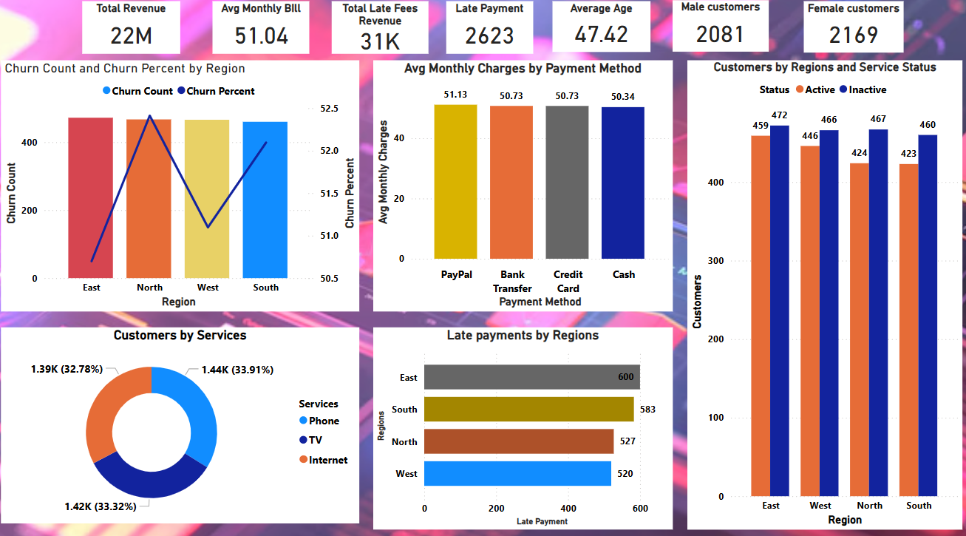

Slide 8
Churn Count and Percentage by Region:
Region | Churn Count | Churn Percentage
East | 472 | 51.2%
North | 467 | 52.3%
West | 466 | 50.8%
South | 460 | 51.8%
Insights -Churn rates are consistent across all regions, suggesting that dissatisfaction isn't location-based but related to service quality or pricing.
North region has slightly higher churn rate, indicating a possible service or demographic issue.
Monthly Charges & Payment Method Trends :
Payment Method | Average Monthly Charge
PayPal | $51.13
Bank Transfer | $50.73
Credit Card | $50.73
Cash | $50.34
Insight:
Customers paying via PayPal have slightly higher bills, potentially more premium users.
Cash users have lowest average bills — may be more price sensitive or less digitally engaged (possibly higher churn risk).
Customers using cash payments have the lowest monthly charges. PayPal users tend to pay slightly higher bills. Understanding why cash-based customers pay less might help pricing optimization.

Slide 9
Customer Preferences by Services :
Service Type | Customer Count (%)
Phone Service | 1.39K (32.78%)
TV Service | 1.42K (33.32%)
Internet Service | 1.44K (33.91%)
Insight : Internet services have slightly more customers compared to TV and Phone services. Offering bundled plans could improve retention rates.
TV service slightly leads in customer volume.
Service distribution is well balanced, ideal for cross-selling/upselling campaigns.
Late Payments by Region :
Region | Late Payments
East | 600
South | 583
North | 527
West | 520
Insight: Higher late payments in the East and South regions might correlate with higher churn rates. Customers struggling with payments may be more likely to leave.
East and South regions have more payment delays, which may correlate with churn risk and customer dissatisfaction.
Include payment behavior in churn prediction models.

Slide 10
Strategies to Reduce Churn :
1) Improve Customer Retention Efforts -
Implement personalized offers for long-tenure customers.
Increase customer engagement through proactive communication.
Predict churn likelihood using machine learning models.
2) Address High Late Payment Rates -
Offer grace periods or flexible payment plans.
Improve billing transparency to reduce frustration.
Focus on North & South regions; explore service complaints or plan competitiveness.
3) Optimize Pricing & Service Bundles -
Introduce discounted TV + Internet bundles to encourage retention.
Conduct competitor pricing analysis to ensure competitive rates.
Promote Internet+TV or Phone+Internet bundles — service mix is balanced.
4) Monitor & Improve Customer Support -
Reduce complaint resolution time.
Launch a customer feedback program to understand pain points.
Automate reminders or provide digital payment discounts in East/South.
5) Reduce Churn Through Incentives -
Reward on-time payers with small discounts.
Introduce loyalty programs for customers at risk of leaving.
Offer incentives to Cash payers, who might be more churn-prone

Slide 11
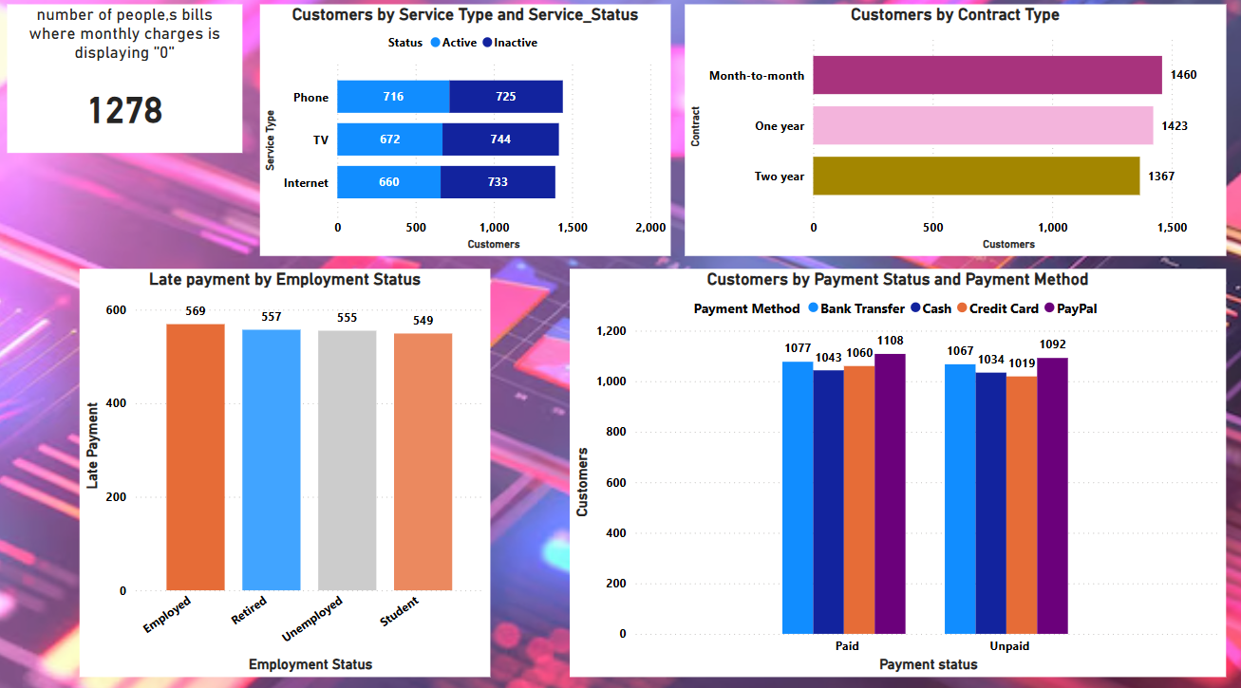

Slide 12
Key Insight: ₹0 Monthly Charges (1,278 Customers)
These customers are either:
On free trials or promo offers.
Have service issues or billing bugs.
Possibly inactive or recently canceled but not updated in billing.
Impact on Churn:
High churn potential. Users with ₹0 charges may not be paying because they’ve:
Stopped using the service.
Received waiver after complaint.
Are in “grace period” before deactivation.
Suggestions :
Investigate this group for billing/accounting gaps.
Run a targeted reactivation campaign.
Contract | Customer Count | Churn Risk
Month-to-Month | 1,460 | High
One Year | 1,423 | Medium
Two Year | 1,367 | Low
Churn Risk by Contract Type :
Insight :
Customers with month-to-month contracts are most likely to churn since they lack long-term commitment.
Month-to-month customers typically show highest churn, as there’s no commitment.
Target this group with:
Long-term plan discounts.
Loyalty reward programs.

Slide 13
Late Payments by Employment Status :
Employment Status | Late Payments
Employed | 569
Retired | 557
Unemployed | 555
Student | 549
Insight: Payment issues persist across all employment categories, potentially leading to churn.
There’s no significant difference across employment types in late payments.
Employment type may not be a strong predictor alone, but when combined with contract/payment method it might reveal deeper insight.
Customers by Payment Status & Method :
Payment Method | Paid Customers | Unpaid Customers
Bank Transfer | 1,077 | 1,067
Cash | 1,043 | 1,034
Credit Card | 1,060 | 1,019
PayPal | 1,108 | 1,092
Insight: High unpaid balances across all payment methods may indicate billing issues or dissatisfaction with payment processes.
High unpaid numbers regardless of method — around 50% unpaid.
Slightly better performance for PayPal (paid vs unpaid), but difference is marginal.
Impact on Churn:
Unpaid users are at high churn risk.
Recommendation :
Friendly reminders.
Auto-pay enrollments.
Payment method incentives

Slide 14
Recommended Strategies to Reduce Churn :
1) Improve Customer Retention Efforts -
Offer discounts or better loyalty programs for long-tenure customers.
Proactively reach out to high-risk churn customers via email or calls.
2) Focus on Contract Optimization -
Provide incentives to shift customers to annual contracts for increased retention.
3) Address Billing Issues -
Need to Investigate ₹0 bill customers and reconcile active/inactive flag
Improve billing clarity and auto-payment engagement
Introduce flexible payment plans to reduce late payments.
Improve billing transparency and communication to minimize disputes.
4) Improve Service Quality -
Offer bundle discounts for TV + Internet customers to boost engagement.
Enhance customer support response time to improve satisfaction.
5) Target Month-to-Month Customers -
Provide exclusive promotions to convert them into long-term subscribers.
Convert month-to-month customers with multi-month renewal offers
Bundle Internet + TV to increase stickiness
Offer "Pay Early & Save" plans for frequent late payers.

Slide 15
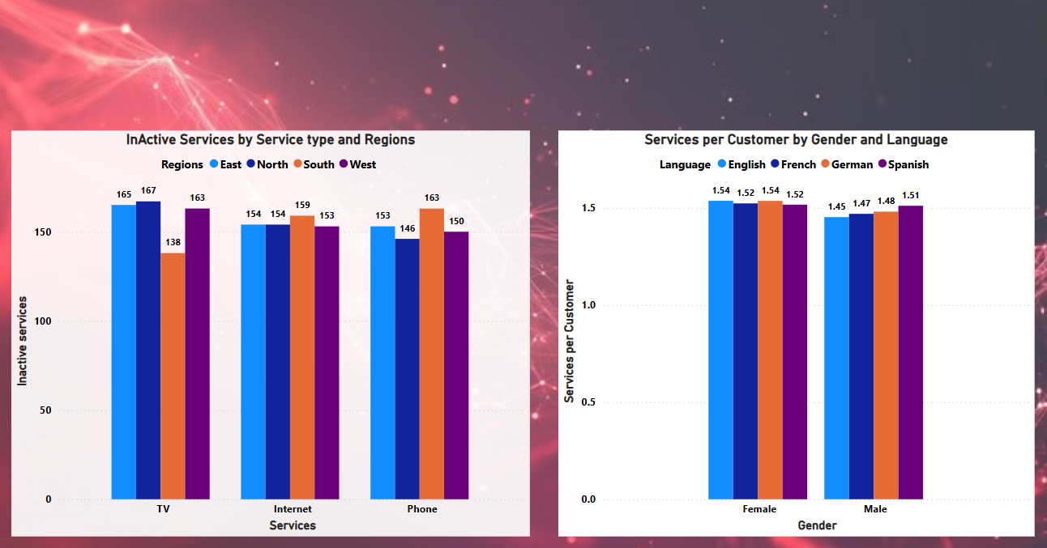

Slide 16
Inactive Services by Service Type & Region
Service | East | North | South | West | Insight
TV | 165 | 167 | 138 | 163 | High inactivity overall. South has lower churn in TV.
Internet | 154 | 154 | 159 | 153 | Fairly balanced, slight spike in South.
Phone | 146 | 163 | 150 | 153 | North shows peak inactivity. East lowest churn here.
Overview :
TV Service: The North region shows the highest total churn across Phone and TV, suggesting service dissatisfaction. North region has the highest number of inactive TV services (167).
South region has the lowest inactive TV services (138) and has lowest TV churn.
Internet Service: South leads with 159 inactive Internet services. The difference between regions for Internet is less pronounced compared to TV.
Phone Service: South region sees the highest number of inactive phone services (163). North has the lowest inactive Phone services (146).
Suggestions –
The North region consistently has high inactive TV services, while the South region leads in inactive Internet and Phone services.
The North region needs a focused approach to reduce TV service churn. North region needs service quality intervention for TV and Phone.
The South region shows high phone inactivity, indicating potential dissatisfaction with phone services. The South region has the lowest inactive TV services but the highest in other categories.
South needs Internet package review or performance enhancements.
Internet inactivity is evenly distributed, suggesting a consistent churn rate that needs broader strategic action.
Need to Consider regionalized promotions to reactivate churned services. Inactive service counts are generally close across regions, with the exception of TV in the South.

Slide 17
Services Per Customer by Gender and Language -
Overview –
Females show higher average services per customer, indicating stronger cross-product adoption and retention. Female customers generally have a higher average number of services (1.52-1.54) across all languages. English and German-speaking females have the highest average services per customer (1.54).French and Spanish-speaking females are slightly lower (1.52).
Male customers have a slightly lower average (English: 1.45). Spanish-speaking male customers have the highest average (1.51) ,German-speaking males are next (1.48), followed by French (1.47).
Suggestions and insights –
Target male-English users with upselling and service bundling offers. English-speaking males have fewer services per customer, warranting targeted engagement. Among males, Spanish speakers have the highest average services per customer.
Female customers seem to be more engaged, potentially indicating higher retention rates. Female customers generally have more services per customer than male customers across all languages.
The difference between languages is minor, but English and German-speaking females are the most likely to have multiple services.
Regional –
North: Offer retention bundles for Phone and TV, run service quality survey. Offer exclusive TV service upgrades or discounted reconnection plans to reduce TV churn.
South: Focus on Internet experience improvements. Address phone service dissatisfaction by enhancing service quality or bundling phone-internet deals.
West: Maintain internet engagement through service enhancements, streaming offers, or loyalty incentives.
Personalized Engagement Based on Customer Profile –
Introduce gender-specific marketing strategies to increase male customer engagement.
Create language-based service bundles to leverage Spanish-speaking customer retention.
Offer customized subscription plans with tailored promotions for English-speaking male customers.
For TV, assess pricing, content variety, and usage drop-off causes.
Internet plan adjustment based on churn region.
Consider tailored marketing for male customers, especially English speakers, to increase multi-service adoption.
Improve Service Experience –
Conduct user surveys in high-churn regions to understand dissatisfaction drivers.
Enhance customer support responsiveness to address service complaints before churn occurs.
Improve service reliability and speed, especially in regions with high inactivity rates.
Focus retention efforts on regions and services with the highest inactivity (e.g., TV in the North, Internet/Phone in the South).

